Slide 1
GENGD 301: BASIC GRAPHIC DESIGN
RQF :LEVEL 3
Sector: ICT & MULTIMEDIA
Trade: Software Development
Learning hours: 100hrs
Trainer’s name: RWEMARIKA JEAN LOUIS

Slide 2
Purpose statement
This general module describes the skills required to design infographic objects using Adobe Photoshop and Adobe Illustrator. Upon completion of this module, the learner will be able to: Edit photos, Design Icons, Design Logos, Design web based Banners, and Design Flyers.

Slide 3
Course content
Learning outcome 1:Edit photos with Adobe Photoshop
1.1. Edit photos with Adobe Photoshop 1. 2. Manipulate graphics with adobe illustrator 1. 3. Export files
Learning outcome 2: Manipulate graphics with adobe illustrator
2.1. Description of workspace
2.2. Create vector paths
2.3. Design shapes
2.4. Description of brand identity
2.5. Design infographics
Learning outcome 3: Export file
3.1. Selection of file format
3.2. Set image quality
3. 2. Export artwork

Slide 4
0. General introduction
0.1 Introduce graphic design basics
0.1.1 core concepts and elements of Graphic Design
Graphic design, the art and profession of selecting and arranging visual elements—such as typography, images, symbols, and colours to convey a message to an audience.
A graphic designer is a professional within the graphic design and graphic arts industry who assembles together images, typography, or motion graphics to create a piece of design.
A graphic designer creates the graphics primarily for published, printed or electronic media, such as brochures (sometimes) and advertising
Graphic Designer create visual concepts, by hand or using computer software, to communicate ideas that inspire, inform, or captivate consumers.
They develop the overall layout and production design for advertisements, brochures, magazines, and corporate reports.

Slide 5
0.1.2 Graphic designer Duties/responsibilities
Graphic designers typically do the following:
Meet with clients or the art director to determine the scope of a project.
Advise clients on strategies to reach a particular audience.
Determine the message the design should portray.
Create images that identify a product or convey a message.
Develop graphics for product illustrations, logos, and websites.
Select colors, images, text style, and layout.
Present the design to clients or the art director.
Incorporate/join changes recommended by the clients into the final design.
Review designs for errors before printing or publishing them.

Slide 6
0.1.3: Identify essential elements of design
1. Form: how visuals come together or are constructed as a larger whole.
2. Shape: the use of different shapes to organize ideas, emphasize specific details, or otherwise punctuate a design piece.
3. Line: Depending on their form, weight, length and context, lines can help organize information, define shapes, imply movement, and convey emotions.
Lines can:
…be horizontal, vertical or diagonal.
…be straight, curved or freeform.
…zigzag or create other patterns.
…be solid, broken or implied.
4. Space: the use of closeness, distance, and overlap to enhance the quality of a piece of design. Spacing is a vital part of any designer’s toolkit. It can give a design breathing room, increase its visual impact, balance out heavier visual elements, and emphasize images or messages that viewers should remember. Without enough space, a design can risk becoming too visually cluttered for your audience to understand.

Slide 7
5. Texture: the use of patterns, animations, and other visual elements that deepen the physical appearance of a design.
6. Size: the consideration of largeness and smallness of different elements in a design piece in order to most effectively communicate ideas or messages.

Slide 8
7. Color: Color conveys messages and can create a sense of emotion or mood. The different colors used to make a design attractive and easy-to-use.
There are three different types of colors:
Primary
Secondary
Tertiary colors

Slide 9
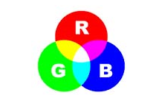
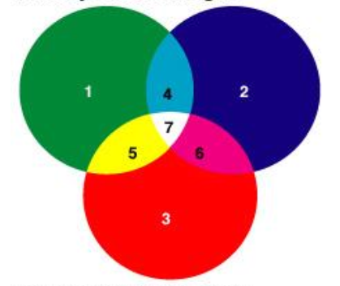
1. Primary colors
Primary colors: primary colors are red, green, and blue; this means that, by additively mixing the colors red, green, and blue in changing amounts, almost all other colors can be produced.

Slide 10
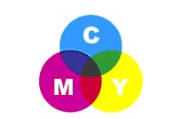
2. Secondary colors
Secondary colors: A secondary color is a color made by mixing of two primary colors in a given color space.
The secondary colors are cyan (a mixture of blue and green),magenta (a mixture of blue and red), and yellow (a mixture of green and red).

Slide 11
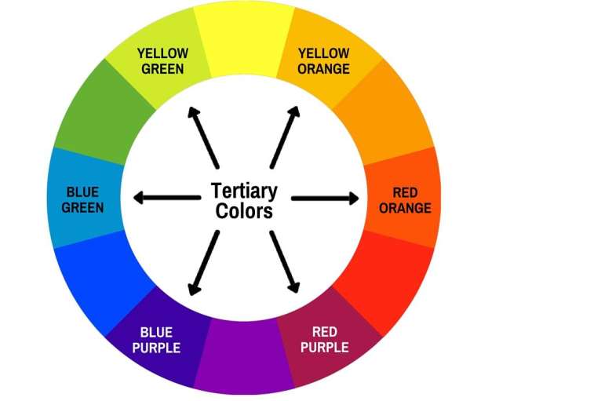
3. Tertiary colors
Tertiary colors: Tertiary colors are the resulting color formed when an equal amount of a primary and a secondary color are mixed. For example, a mixture of 50-percent red and 50-percent magenta would result in the tertiary color of orange.

Slide 12
Learning outcome: Edit photos with Adobe Photoshop.
Definitions:
1. What is Photoshop?
Photoshop is an image-editing and graphic design software created in 1988 by Thomas Knoll and John Knoll and the official distribution license of the program was purchased by Adobe Systems. Since then, so many Photoshop versions have been released.
Adobe is an American software company

Slide 13
2. Image editing or photo retouching; Editing is a basic correction of images whereas retouching is actual photo manipulation to change the look.
Image editing refers to modifying or improving digital or traditional photographic images using different techniques, tools or software.
Images produced by scanners, digital cameras or other image-capturing devices may be good, but not perfect.
Image editing is done to create the best possible look for the images and also to improve the overall quality of the image according to different parameters.
Image editing is done for removing unwanted elements such as dust specks (a very small mark )and scratches, adjusting the geometry of the image like rotating and cropping, correcting for lens aberrations, sharpening or softening the image, making color changes or adding special effects to the image.

Slide 14
3. What's the difference between an image, photo, and a picture?
Image - Any visual object that's modified or altered by a computer or an imaginary object created using a computer.
Photo or photograph - Anything taken by a camera, digital camera, or photocopier.
Picture - A drawing, painting, or artwork created on a computer. A picture is also used to describe anything created using a camera or scanner.
A picture is the most general term for any representation of a person, an object or a landscape. It can be a painting or a pencil drawing, etc.

Slide 15
Use of Photoshop Interface elements
Version: Adobe Photoshop CC 2021. Be aware that different versions of Photoshop will vary in appearance and functionality.

Slide 16
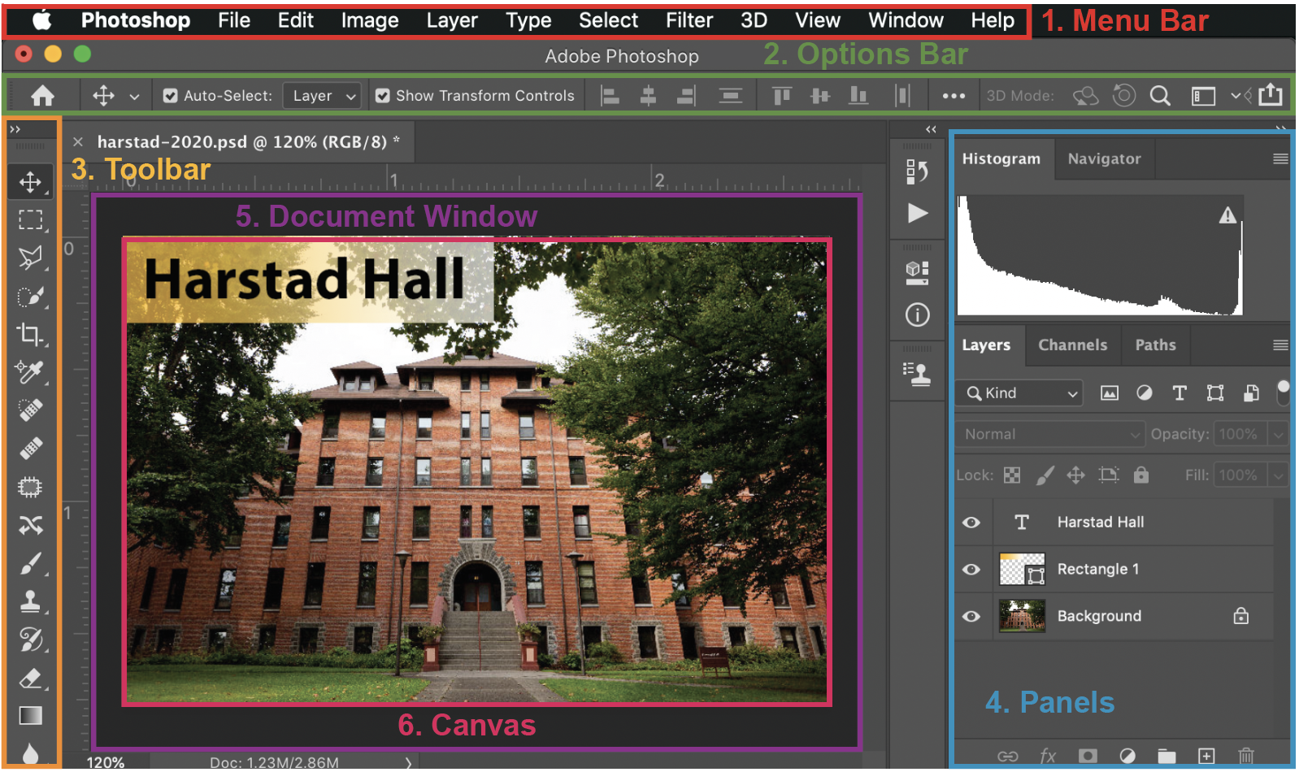
Notes:
Version: Adobe Photoshop CC 2021. Be aware that different versions of Photoshop will vary in appearance and functionality.
Version: Adobe Photoshop CC 2021. Be aware that different versions of Photoshop will vary in appearance and functionality.

Slide 17
1. Menu bar: includes saving options (under File) and interface options (under Window).
2. Options bar: changes depending on what tool is selected. Contains specific options that allow for greater control over elements like shapes and text.
3. Tool bar: used to interact with and add to the document. Many tools have a small white triangle in the bottom-right-corner, which indicates more tools stacked beneath the top tool. To see the additional tools, click-and-hold on the tool icon; a drop-down menu will appear.
4. Panels: provides a way to access important tools and settings quickly. Many panels are available, and some have similar functions as the Options Bar. Panels are organized into tabs. Additional panels can be opened from the Menu Bar under â€œWindow.â€
5. Document window: Where the document design takes place. May display a ruler and guidelines, which are not visible in the final print.
6. Canvas: This is where the editing of the document takes place. When an image is opened, the image itself is considered the Canvas. Objects that are placed outside of the Canvas will not appear after export or printing.

Slide 18
Workspaces
Photoshop contains several preset Workspaces, which change the default panels to better serve particular kinds of projects.
To change the Workspace, navigate to Windows > Workspaces. For in-depth photo editing, use the Photography Workspace.
If at any point a panel is closed or moved, the interface can be reset by navigating to Window > Workspace, and selecting the â€œResetâ€ option (i.e. â€œReset Photographyâ€).

Slide 19
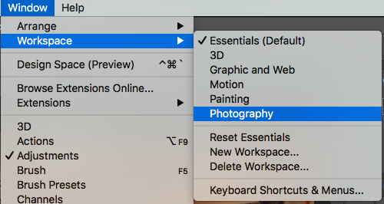

Slide 20


Using Panels
The panels on the right side of the interface will change depending on what Workspace is currently active, but all panels are available in any Workspace.
To access a panel not currently visible, navigate to Windows and select the desired panel. Panels with a check-mark to the left are currently accessible from the main interface.
To open panel or tab to access its options, click its name. Panels are located on the right of the interface.
To expand or collapse a panel, click the double-arrows in the top-right corner of the panel. Left-facing arrows will expand the panel, and right-facing arrows will collapse it.
To access additional panel options, click the four stacked lines at the top-right corner of the panel. Important options, such as for deleting or duplicating elements, are located here.

Slide 21
Zooming In and Out
It may be necessary to zoom in or out on certain portions of a photo.
On the bottom-left of the Photoshop window there is a zoom percentage that shows the amount the image has been zoomed in-or-out in comparison to the original size.
To zoom in, select the Zoom tool from the Toolbar and click the image. Each consecutive click will zoom in further. Alternatively, press Command+(+) (Mac) or CTRL+(+) (Windows).
To zoom out, hold the Option key and click the image with the Zoom tool. Alternatively, press Command+(-) (Mac) or CTRL+(-) (Windows).

Slide 22
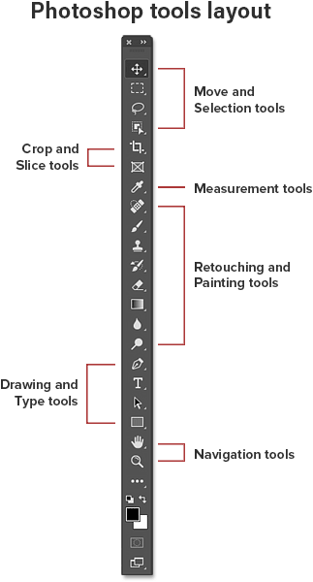

Slide 23
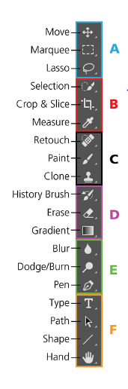
Tools & Subtools

Slide 24
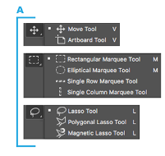

Slide 25
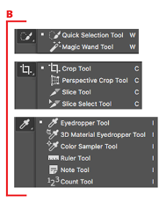

Slide 27
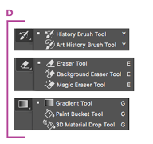

Slide 28
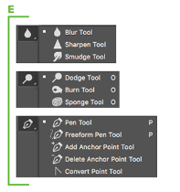

Slide 29
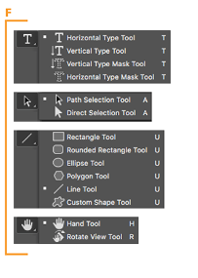

Slide 30
Using keyboard shortcuts
A. Photoshop Keyboard Shortcuts: Move Tools
Zoom Tool - Hit the letter “Z” on your keyboard
Zoom Out - Hold the Alt/Option key
Fit to Screen - Command/Ctrl + 0
Hand Tool - Move around the image while zoomed in - Hold the spacebar
Rotate Your Image - Hit the letter “R” on your keyboard, then click and drag your mouse
Rotate in 15 degree increments - Make sure your rotate tool (R) is selected + hold shift and drag your mouse

Slide 31
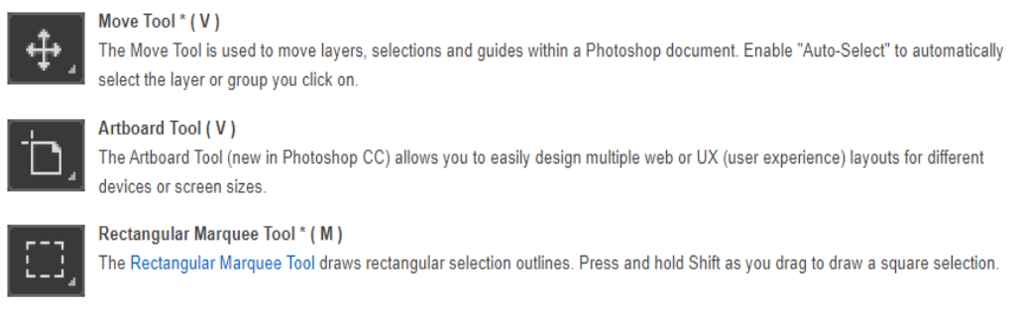
Photoshop Tools Summary 1.Move and Selection tools

Slide 32
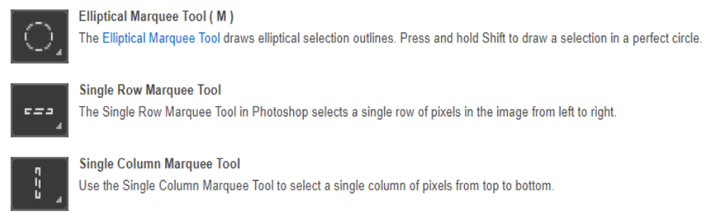

Slide 33
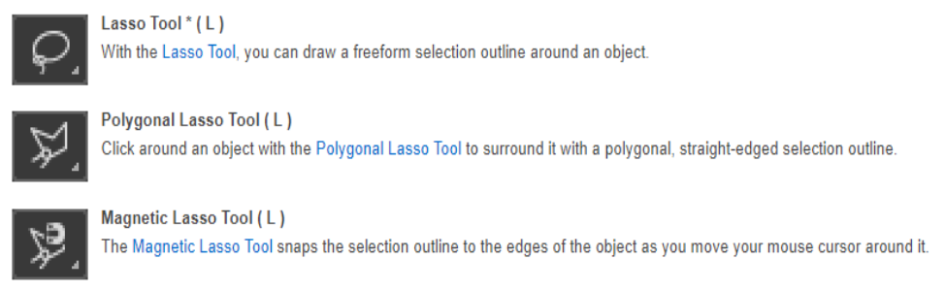

Slide 34
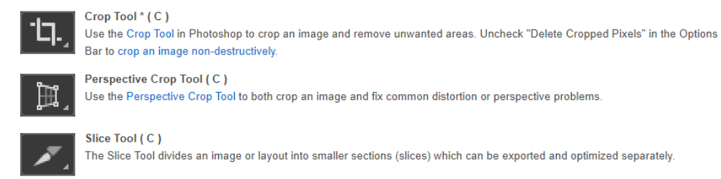

Slide 35
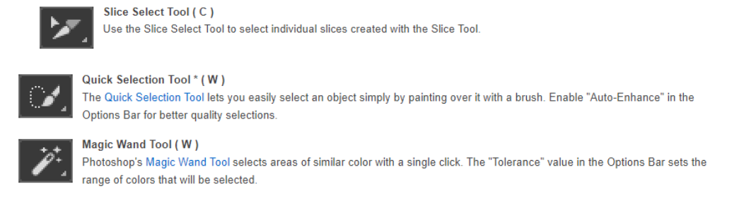

Slide 36
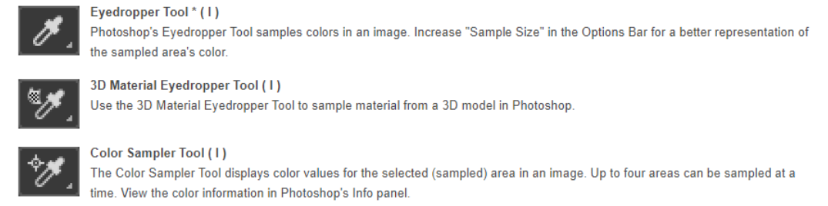
Measurement tools

Slide 37
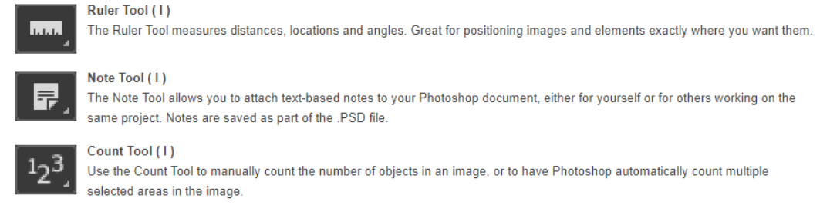

Slide 38
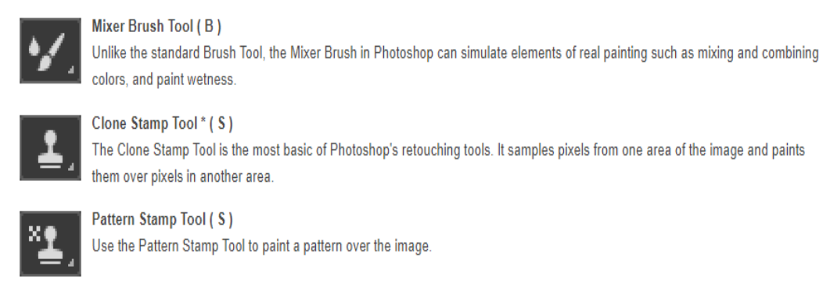

Slide 39
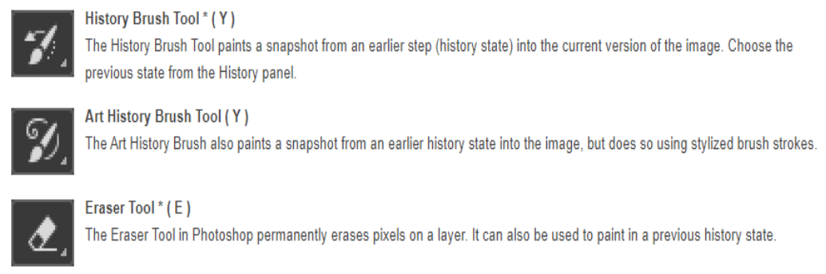

Slide 40
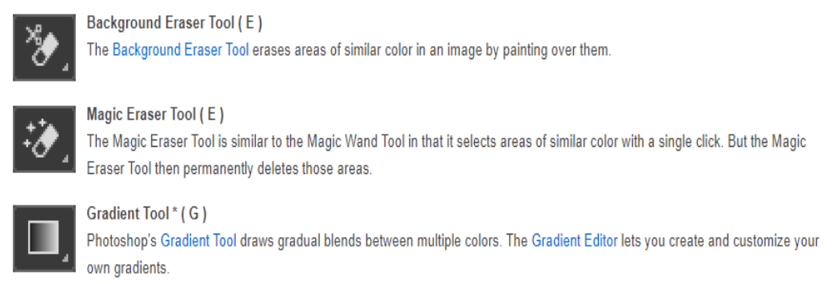

Slide 41
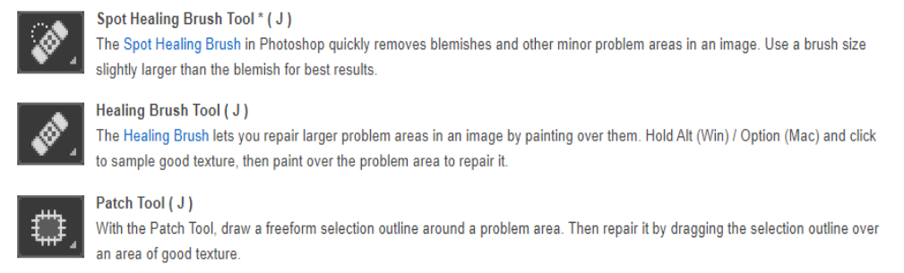

Slide 42
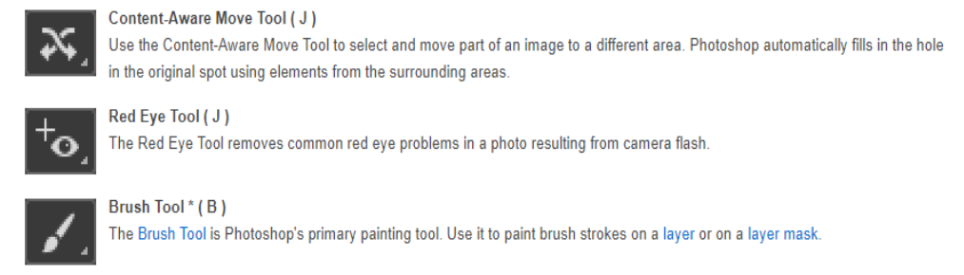

Slide 43
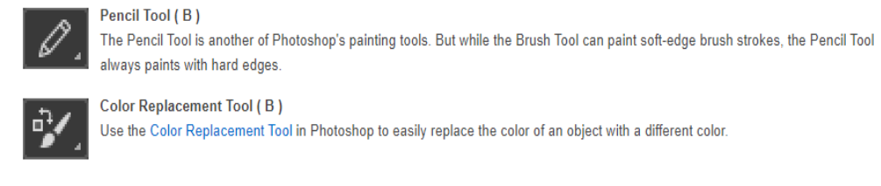

Slide 44
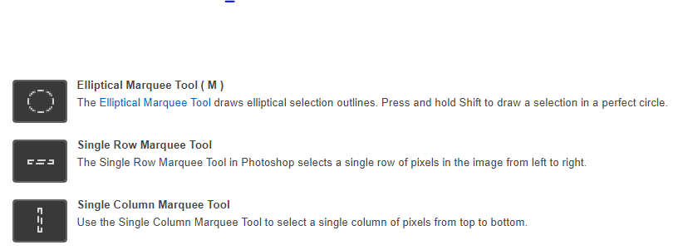

Slide 45
A.Photoshop Keyboard Shortcuts: General Tips & Shortcuts
Unlock your background layer - Double click your background layer and hit the “enter” key or simply click on the lock icon on your background layer.
Rulers - Command/Ctrl + R
Create Guides - Click and drag from the rulers while they are visible. This works both on the vertical and horizontal axis
Hide/Show Guides - Command/Ctrl + H
Undo - Command/Ctrl + Z (quick tip: use this keyboard shortcut over and over again to toggle your last history state)
Multiple Undos - Command/Ctrl + Alt/Opt + Z
Gradient Tool - Hit the letter “G” on your keyboard

Slide 46
Gradient Tool with straight gradient - While the gradient tool is selected, hold “Shift” then click and drag
Crop Tool - Hit the letter “C” on your keyboard (Quick Tip: make sure to uncheck “Delete cropped pixels”)

Slide 47
Access Photoshop Tool subsets - Hold the shift key, then press the keyboard shortcut for the tool you are trying to access.
Doing so multiple times will let you toggle between the sets of tools available in any given panel.
For example hitting the letter “J” on your keyboard would let you healing brush tool. If you hold the shift key + hit the letter “J” on your keyboard, you will cycle all of the healing brush tool subsets.
The helpful shortcut works for all of the tools in the tool panel that have more than one tool available.
Quick Tip: Hover of the tools panel to reveal the keyboard shortcut for the tool your hovering over

Slide 48
Photoshop Keyboard Shortcuts: Brush Tool
Brush - Hit the letter “B” on your keyboard
Make brush tool bigger - Hit the ] key on your keyboard (right bracket key)
Make brush tool smaller - Hit the [ key on your keyboard (left bracket key)
Brush Resize (PC) - Right Click + Alt + Drag left or right

Slide 49
Brush Softness (PC) - Right Click + Alt + Drag up or down
Brush Resize (Mac) - Command + Option + Drag left or right
Brush Softness (Mac) - Command + Option + Drag up or down
Brush settings - Simply right click while you have the brush tool selected. Hit the “enter” key to exit this panel
Sample colors while using the brush tool - Hold the Option/Alt key to temporarily switch to the eye dropper tool

Slide 50
Photoshop Keyboard Shortcuts: Color
Eyedropper Tool - Hit the letter “I” on your keyboard
Toggle Foreground/Background Color - Hit the letter “X” key on your keyboard
Default Colors - Hit the letter “D” on your keyboard

Slide 51
Photoshop Keyboard Shortcuts: Selection Tools
Magic Wand Tool - Hit the letter “W” on your keyboard
Add to Selection - Hold Shift key while using a selection tool
Marquee Selection Tool - Hit the letter “M” on your keyboard
Deselect - Command/Ctrl + D
Lasso Tool - Hit the letter “L” on your keyboard
Pen Tool - Hit the letter “P” on your keyboard
Load Pen Path Selection - Once you have a closed path, hit Command/Ctrl + Enter to load the selection
Create Bezier Curve - With the pen tool selected (letter P) click to add an anchor point, then click and drag to add another

Slide 52
Photoshop Keyboard Shortcuts: Retouching Tools
Healing Brush Tool - Hit the letter “J” on your keyboard
Toggle between Healing Brush Subsets - Hold Shift + hit the letter “J” on your keyboard
Healing Brush sample point - Hold Option/Alt, then click to choose a sample point
Clone Stamp Tool - Hit the letter “S” on your keyboard
Clone Stamp Tool sample point - Hold Option/Alt, then click to choose a sample point

Slide 53
Digital images key features
Pixel
Resolution
Size
Lossy image file compression
Lossless image file compression
Raster graphics
Vector graphics

Slide 54
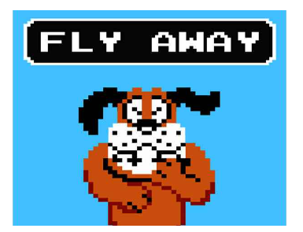
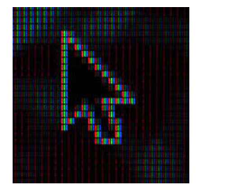
1. Pixel
A pixel is the smallest unit of a digital image or graphic that can be displayed and represented on a digital display device.
A pixel is represented by a dot or square on a computer monitor display screen.
A pixel is the basic logical unit in digital graphics. Pixels are combined to form a complete image, video, text, or any visible thing on a computer display.

Slide 55
2. Resolution
Resolution refers to the number of pixels in an image. Resolution is sometimes identified by the width and height of the image as well as the total number of pixels in the image.
For example, an image that is 2048 pixels wide and 1536 pixels high (2048 x 1536) contains (multiply) 3,145,728 pixels (or 3.1 Megapixels). You could call it a 2048 x 1536 or a 3.1 Megapixel image.
As the megapixels in the pickup device in your camera increase so does the possible maximum size image you can produce. This means that a 5 megapixel camera is capable of capturing a larger image than a 3 megapixel camera.

Slide 56
Image resolution is typically described in PPI, which refers to how many pixels are displayed per inch of an image.
Higher resolutions mean that there more pixels per inch (PPI), resulting in more pixel information and creating a high-quality, crisp image.
Images with lower resolutions have fewer pixels, and if those few pixels are too large (usually when an image is stretched), they can become visible like the image below.

Slide 57
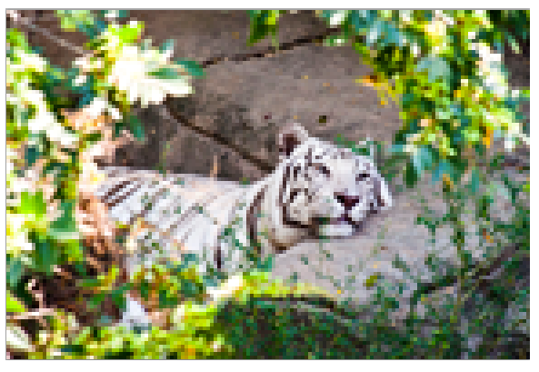

Slide 58
If you are going to put your image on a webpage or email it to a friend then you will want to first make it a useful size. Not too big, not too small. Maybe 200-300 pixels high would be a nice size.
You can also reduce the size of the file (not necessarily the size of the image) so it loads faster. You reduce the file size by compressing the image

Slide 59
3. size
Image size refers to the width and height of an image, in pixels. It also refers to the total number of pixels in the image, but it's really the width and height we need to care about.
The picture size is measured in pixels, also can measured in byte.
Data Compression is a method of decreasing the size of the data without significant/importance loss of information.

Slide 60
Physical vs Memory Size
Physical Size: The physical size of an image refers to the dimensions in which it would print (ex: 8.5" x 11") or the pixels dimensions of an image displayed on the web (ex: 600 pixels x 800 pixels).

Slide 61
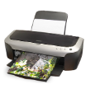

Slide 62
Memory Size:The memory size is how much memory an image file takes up on a hard drive. For example, a JPG image saved on a computer may be 2 MB (megabytes), meaning that it will require 2MB of space on a drive to store that image.

Slide 63
8bits= 1byte
A bit is 1 unit of memory represented by 1 or 0.
A kilobyte=1024 bytes and can store about 1000 characters.
A megabyte is approximately 1000KB (i.e. 1024 KB) and can store about 1 million characters.
A gigabyte is approximately 1000MB (i.e. 1024 MB) and can store 1 about billion characters.
A terabyte is approximately 1000GB (i.e. 1024 GB) and can store 1 about trillion characters.

Slide 64
Bit: A bit is the smallest unit of information that can be represented in a computer. Bit stands for binary digit. It takes the value 1 or 0.
Byte: Is a unit of information made up of 8 bits. It is the standard basic unit for measuring memory size in digital devices. It makes it possible for example to store a character such as a letter or a figure. A unit of information made up of 16bits is generally called word.
A unit of information of 32bits length is called double word. For a byte, the smallest number is 0 (represented by 8zeros 00000000) and greatest is 255 (represented by 8 digits”one”11111111).
Nibble: This is half a byte i.e a group of 4 bits.
Word: two or more bytes make a word. Word length is a term used to refer to the measure of number of bits in a word. A word can have a length of 16bits, 32bits, 64bits etc.

Slide 65


Slide 66
4. Lossy image file compression
Lossy image compression is a process that removes some of the data from your image file, reducing the overall file size. The .JPEG format is an excellent example of lossy compression.
Common lossy compression-based image formats are JPEG and MPEG.
PNG: Portable Network Graphics format.
TIFF: Tagged Image File Format.
JPEG: Joint Photographic Experts Group format.
GIF: Graphics Interchange Format.

Slide 67
5. Lossless compression
Lossless compression: means that as the file size is compressed, the picture quality remains the same. The types of format that can benefit from lossless image compression are .RAW, .BMP, .GIF, and .PNG. Lossless image file compression: Permanently removes data.

Slide 68
6. Raster graphics
Also called:
bitmap graphics
Raster graphics is that raster graphics are composed/made up of pixels, which are small squares of color.
Raster images can't be scaled up without losing quality, but they can be scaled down without any problems. They are often used for photos and other complex images.
The most common raster file formats are JPEG, PNG, GIF, BMP.

Slide 69
7. Vector image
Vector images are made up of lines and shapes that are mathematically defined. This means that they can be scaled up or down without losing any quality. They are often used for logos and illustrations.
The most common vector file types are SVG (Scalable Vector Graphics). PDF, .AI (adobe illustrator),

Slide 70
Describing common raster formats
Format | Description
.JPEG | JPEG. Stands for "Joint Photographic Experts Group." JPEG is a popular image file format. use this file when sending images for your company's website or social media page. If you save this file multiple times, it will continue to compress, which means it will lose quality, so consider using this file when you plan to use it immediately.
.PNG | • PNG stands for Portable Network Graphic • you can use a PNG format for sending images for web pages, such as logos or photographs. This format maintains its size and quality throughout multiple saves and changes. It's lower resolution than other file types, so it's best for websites rather than printed images.

Slide 71
GIF | Stands for "Graphics Interchange Format. GIF is an image file format commonly used for small or simple animated files(website, communication site or social media platform.)
.TIFF or TIF | TIFF of TIF: Tagged Image File A TIFF file is a high-quality image file type. You may use this file type when scanning documents, using a desktop publisher program or printing high-quality items. This can help you print high-resolution images. This is a large file type, so it's best to use an alternative image file type for your websites and web pages.
.BMP | • The BMP file format standard for bitmap • Handles graphic files within the Microsoft windows os

Slide 72
PDF | PDF (Portable Document Format) also is Printer Definition File is a common file type in many work environments. This file maintains the original document layout, which makes it helpful for signing paperwork and sharing plans. You can email, print and scan using this file format. This is a popular choice when sending or uploading resumes, as it maintains the document's original layout and formatting.
RAW | • Raw file is a collection of unprocessed data. • Raw files are often used as data files by software programs that load and process the data.
.CR | CR stands for Canon RAW and belongs to the group of RAW image file formats.
.CR2 | CR2 stands for Canon RAW 2nd edition and belongs to the group of RAW image file formats.
.DNG | • DNG stand for Digital Negative • was created to store image data in a generic, highly-compatible format, unlike RAW files that have specific formats based on manufacturer and camera type

Slide 73
7. Describing common vector formats
Format | Description
SVG | SVG stand for Scalable Vector Graphics Files • This file type is most common in website design. If you're designing a logo or graphic for a client's website or your company's website, you may work with SVG files. This extension supports smaller image files and short animations. This file type maintains a clear resolution and may work well with search engines, which could help clients find your graphic.
EPS | • EPS stands for Encapsulated PostScript • Used in vector-based images in Adobe Illustrator

Slide 74
1.1.4 Describing application formats
Photoshop(PSD)
stands for Photoshop Document
Is the default format that Photoshop uses for saving data?
PSD is a proprietary file that allows the user to work with the images' individual layers even after the file has been saved.

Slide 75
PSB Stands for (Photoshop Big)
File extension is an Adobe Photoshop Large Document file.
Illustrator (AI)
AI file extension represents Adobe Illustrator Artwork file.
This graphics file is a creation of Adobe systems for containing vector based graphics in a single page.

Slide 76
InDesign(INDD)
An INDD file is a professional page layout project created with Adobe InDesign.
It includes page formatting information, page content, linked files, styles, and swatches.
INDD files are commonly used for creating and formatting books, magazines, newspapers, flyers, and brochures.

Slide 77
L.U 3: Apply illustrator basics
Adobe Illustrator is a popular software application frequently used by artists ,graphic designers, web designers, and illustrators to create vector graphics/illustrations (any thing you can imagine).
It offers sophisticated digital drawing tools for creating logos, icons, drawings, typography, and complex illustrations for any medium.
Vector graphics is a form of computer graphics in which visual images are created directly from geometric shapes defined on a Cartesian plane, such as points, lines, curves and polygons.

Slide 78
Key terms in illustrator
Path: A line in Illustrator is called a path which is composed of at least two anchor points, a start and an end anchor point.
Artboard: In Illustrator, an artboard is like a sheet of white paper that forms the base for your artistic work. An Artboard in Illustrator works like a physical piece of paper on a desk.
Simply It's an empty space where you express your creativity in the digital world.
An illustrator: a person who draws pictures for books, magazines, etc
Artwork: something that is created with imagination and skill and that is beautiful or that expresses important ideas or feelings
Or
The pieces of art, such as drawings and photographs, that are used in books, newspapers, and magazines,..
Art is the expression of ideas and emotions through a physical medium, like painting, sculpture, film, dance, writing, photography, or theatre.

Slide 79
What is vector-based imaging mean?
It means that your image can be scaled it can be scaled to any size without losing quality.
This allows for flexible artwork that can be used at various different sizes.
In contrast, bitmap images (also known as raster images) are made up of pixels, which can become blurry or distorted when they are enlarged.

Slide 80
What is Adobe Illustrator used for?
Illustrator is used to create scalable vector art for using projects for both print and web.
Adobe Illustrator is commonly used to create logos, promotional or branded content, icons, website graphics, digital artwork, and more.
It is popular in the business world for graphic design projects related to marketing, advertising, and branding, as well as with artists who create digital artwork personally and professionally.

Slide 81
Introduction: Creating a Workspace Illustrator Workspace Overview
The Adobe Illustrator has an efficient work area and user interface to create and edit our designs and artwork for print, using on the web, and on mobile devices.

Slide 82
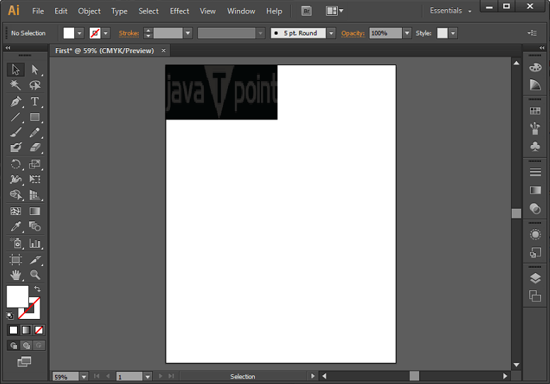

Slide 83
Create a new document in Illustrator
1) Launch Adobe Illustrator.
2) Go to File > New...
3) A dialog box will appear that will allow you to set the parameters for your file.
In Illustrator, you work with Artboards. Note that you can easily change the size of your artboard as you work on it if you need more space

Slide 84
Give your file a name. For now, let’s start with 1 Artboard with the dimensions 600px by 600px. We’ll be working pixels, but feel free to work in any units you are most comfortable in. Lastly, we want it to be in Landscape orientaion. Once you’ve made all those adjustments, click OK

Slide 85
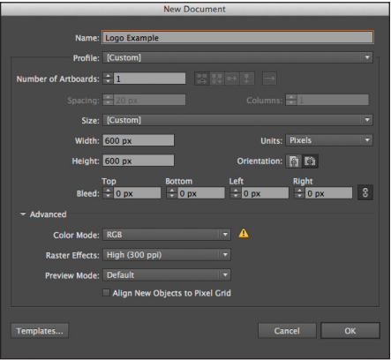

Slide 86
Color Mode: The color mode for the new document will be specified using this option.
If we try to change the color mode, it will convert the default contents of the selected new document profile to a new color mode that results in a change of color-an information message will pop-up before applying the changes.
Raster Effects: This option is used to specify the resolution for raster effects inside the document.
The raster effect is set to high by default. We can fix this to High when we all plan to give output to a high-end printer at very high resolution.
Transparency Grid: This option is used to specify the prospects for the transparency grid for documents of the Video and Film profile.
Preview Mode: The preview mode sets the default view for the document.

Slide 87
Default: It displays artwork created in vector view inside the document with full color. Zoom in/out retains smoothness in the curves.
Pixel: The pixel mode displays artwork with a pixilated appearance. It is used to display a simulated preview.
Overprint: This mode is used to display an "ink preview," which helps to approximate that how transparency, blending and overprinting will appear in color-separated output.

Slide 88
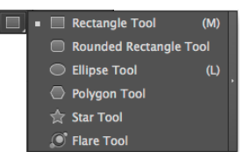
Creating Shapes & Adding Fill and Strokes
1) Click on the Rectangle Tool in the tool bar. If you click and hold on it on the toolbar, you’ll notice lots of different shape tools at your disposal.

Slide 89

2) Click and drag until you’ve got the shape desired or double click on the screen until a dialog window shows up that allows you to input specific dimensions for your rectangle.
You can always adjust the size manually later by dragging the markers around the shape or on the top toolbar, you can adjust the width and height by inputting specific dimensions.

Slide 90

3) Now, we need to change the stroke and fill of our shape. Feel free to make it any color you want.
You can access this in your side toolbar. It usually defaults to a white fill and black stroke. Let us double click on the fill box and change it to a sea foam green.

Slide 91
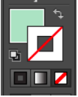
4) Single click on the stroke box and click on the handy ‘No Fill’ button underneath the Stroke/Fill box. My Stroke and Fill now looks like this on the toolbar:

Slide 92

5) My shape appears like this

Slide 93
Using the Paintbrush Tool
To place a cursive lettering of the initials(created logo) on top of the rectangle in white. In this case, let us use the paintbrush tool.
Note: you can also use a premade type here, but we want ours to have a homemade look.

Slide 94


1) Open up the Paintbrush tool.
2) Hold and start painting on your artboard.
3) Change the stroke of your line to white. This is what mine looks like:

Slide 95
You can also make adjusts to the line you’ve created by going to your top toolbar, where you can change the fill/stroke, stoke line width, opacity, and style.
Illustrator gives you lots of options for preset styles. In this case, I’ve used the default 5pt. Round. If you click on the little triangle next to it, it will drop down a menu with different types of brushes that you can use.

Slide 96
Understanding & Drawing Path Points
Paths are the line segments that make up the overall structure of the artwork that you create (the skeleton).
For instance, a rectangle is made up of a path that has four vertical lines that all connect and there are four anchor points (the joints) in the corners. Every shape and object will have path and anchor points.

Slide 97
You can also draw your own paths using the Pen Tool, essentially creating your own artwork within Illustrator.
The Pen Tool has some advanced features, but we’re going to go over basics to using the Pen Tool.
Essentially, you are setting the dots and drawing the lines for your artwork object.
You can create both straight and curved lines.

Slide 98


Slide 99
For my logo, I want to create some abstract shapes underneath my rectangle in different shades of green/blue, which will serve as the background for my title: “Graphic Designer & Artist.” In this case, I just need to draw straight lines with the Pen tool.

Slide 100
1) Select the Pen Tool.
2) Click anywhere to start drawing your object.
3) Continue clicking to create your object.
4) To close your object, click back on the first point. You should see a small circle next to the Pen tool that indicates that you are closing your path. I’m going to continue making abstract shapes until it creates a big enough cluster to add my title.

Slide 101
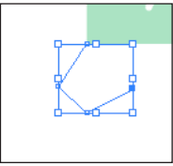

Slide 102


Slide 103

My logo now looks like this:

Slide 104

When working with paths, you can adjust your anchor/paths by using the Direct Selection Tool.
The Direct Selection Tool will allow you to select the points within a path and move them around. For instance, let’s say I draw that last shape and don’t like how it looks.
Instead of creating a whole new path, I can use the Direct Selection Tool to adjust the points.

Slide 105
1) Select the Direct Selection Tool and click on the shape. With this tool, you select points one at a time.
A selected point will be a filled in blue anchor point and an unselected point will have white in the middle

Slide 106
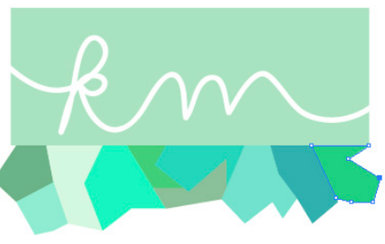

Slide 107
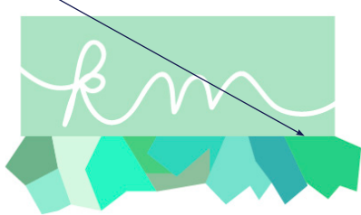
2) Click and drag the anchor points to change the shape of your object. The shape now looks like this:

Slide 108

Now my rectangle doesn’t match my bottom artwork, so now I want to adjust the shape of the rectangle to mimic the at strait look. With the Pen Tool, you can also add and subtract points.
1) Click and hold down on the Pen Tool until you see a drop down menu. Select Add Anchor Point Tool.

Slide 109
2) Now hover over the path of the rectangle and click anywhere on the path to add an anchor point.
3) This will create new Anchor points and you’ll see new blue points on the path. Now, you can use the Direct Selection Tool to move those points around and create a completely new shape.

Slide 110


Slide 111


Using Type & Creating Outlines
Now, I want to add “Graphic Designer & Artist on top of my shapes.
1) Select the Type Tool.
2) Click anywhere and a cursor will appear for you to start typing.
3) Once done typing, click on the Selection Tool to move your text around. This will create a box around your text. Hover over it and you’ll get a cursor that will allow you to move your text around your artboard.

Slide 112
4) Once I’ve placed it on top of my artwork, I can double click on it to highlight the text and change the font/size using the top toolbar. I’ve changed my font to “Modern No. 20”, size 22pt

Slide 113
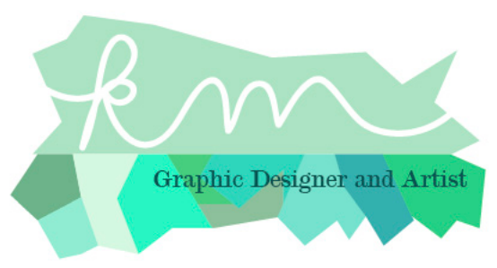

Slide 114
In some cases, you’ll want to convert your text to outlines. This will allow you to manipulate the text in interesting ways. However, you will not be able to use the Text Tool to change what the text says after creating it into outlines.
1) To convert your text to outlines, click on the text with the Selection Tool.
2) Go to Type > Create Outlines. This will create outlines around each individual letter. However, the text is still grouped together. In order to manipulate each letter individually, you’ll need to ungroup the text.

Slide 115
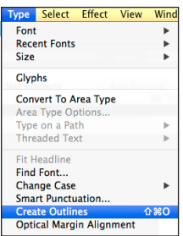

Slide 116
3) Go to Object > Ungroup. You will not be able to select each letter individual and change its size and give the letter different fill/stroke colors.

Slide 117
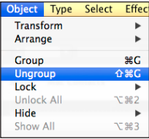

Slide 118

4) Click on the G with the Selection Tool and increase the size by dragging the corner out. Hold down shift at the same time to ensure that it keeps the same proportions.
5) Rotate the letter by using the Rotate tool. You should then be able to click and rotate the object as desired. I did this both for the G and A as pictured below:

Slide 119
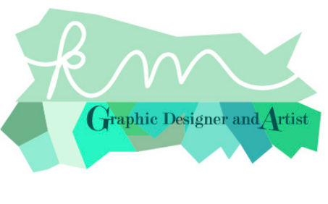

Slide 120
Exporting
Now that I’ve completed my logo, I can adjust my artboard accordingly to fit around my logo.
This is crucial if you want your image to export with certain border dimensions around it.
However, in this case, I’m exporting as a .png to allow the image to have a transparent background.

Slide 121
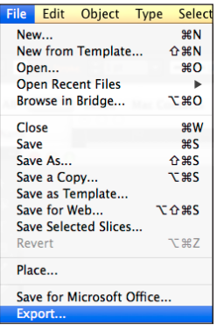
1) Go to File > Export...

Slide 122
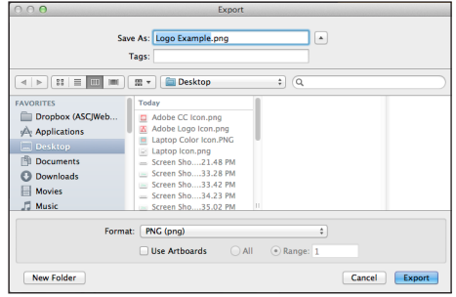
2) A new dialog box will open that allows you to name your file and select the format. I’ve chosen PNG.

Slide 123
3) Once done, click Export.
4) Depending on the format that you select, another dialog box may open that will give you more options in terms of the quality and size of the image file. This will depend on what you need for your image / artwork

Slide 124
Description of brand identity
✔ Brand
✔ Brand identity
✔ Brand icon
✔ Brand identity guidelines
✔ Logo

Slide 125
Brand: Is a Unique design, sign, symbol, words, or a combination of these, employed in creating an image that identifies a product and differentiates it from its competitors.
Brand identity: Is the visible elements of a brand, such as color, design, and Logo, that identify and distinguish the brand in consumer’s minds.(These items are the name, logo, tone, tagline, typeface, and shape that create an appeal.) Brand identity is the message the consumer receives from the product, person, or thing.
Icon: Is a symbol that conveys strong, universal values and ideas that make it immediately recognizable. The icon is just a part of the logo. An icon directly represents and idea, perception, operation or action. Icons simplify or summarize an operation through a graphical representation, and relay this to the user.

Slide 126
WHAT IS A LOGO
Logo is the graphic symbol that represents a person, company or organization.
A good Logo helps customers understand what you do, who you are and what you value.
The most function of a Logo is giving your business a unique mark that that differentiates you from other businesses.

Slide 127
Logo types
A logo is a visual symbol consisting of an image, word, or combination of the two that represents your company.
They are different types of Logos:

Slide 128
Letter marks (or Monogram logos): Is a typographic Logo using only letters.
A letter mark is a typography-based logo that’s comprised of a few letters, usually a company’s initials (Abreviations). E.g:
Cable News Network(CNN)
Home Box Office(HBO)
The National Aeronautics and Space Administration (NASA)
Protector and Gamble(P&G)
Electronic Arts(EA)
As these examples suggest, a letter mark is a good choice for a company whose name is difficult to pronounce, or too long to work as a ;Logo in most media.
e.g: IKEA, CNN, FedEx, McDonalds, Word Press, Yahoo

Slide 129


e.g: IKEA, CNN, FedEx, McDonalds, Word Press, Yahoo

Slide 130
2. Word marks (or logo types)
These types of logos consist of text only – company names, monograms or initials.
Essentially, logotypes are just a company name set in some kind of particular typeface.
e.g: Subway, Uber, Camelback, Coca-Cola, Google, ….

Slide 131

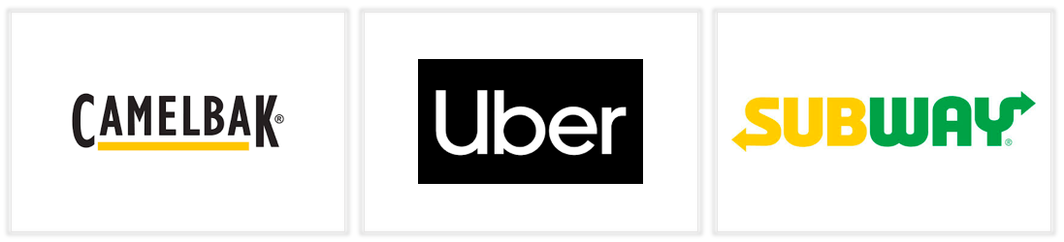

Slide 132
3. Brand marks /Pictorial marks / logo symbols
Also known as a pictorial mark, a brand mark contains no text but is an image, icon or symbol that represents the company or brand. Famous examples include the Apple ,the Nike ‘Swoosh’, the Red Cross symbol …
e.g: Airbnb, Pepsi, Microsoft (Windows)

Slide 133



Slide 134
4. Combination mark
Combination marks logos are comprised of any combination of images and words that you choose.
e.g.Taco Bell, CVS, Toblerone.

Slide 135
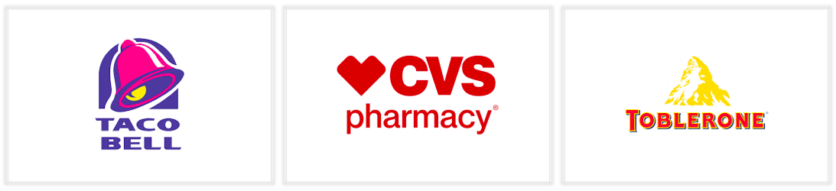
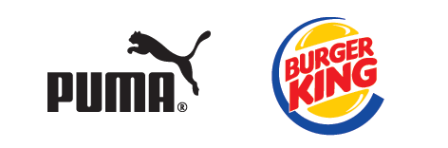


Slide 136
5. The emblem
These logos consist of typeface that sits within a border – usually a seal or a crest. Think universities and government organizations.
E.g: Starbucks, Stella Artois, Superman

Slide 137
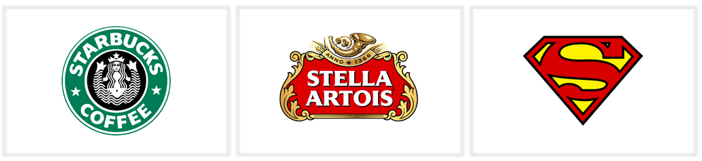

Slide 138
6. Abstract logo marks
An abstract mark is a specific type of pictorial logo. Instead of being a recognizable image— like an apple or a bird—it’s an abstract geometric form that represents your business.
A few famous examples include the BP starburst-y logo, the Pepsi divided circle and the strip-y Adidas flower.

Slide 139
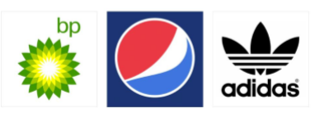

Slide 140
Logo design considerations
What makes a good logo?
A good logo is distinctive, appropriate, practical, graphic, simple in form and conveys an intended message. There are five principles that you should follow to ensure that this is so… An effective logo is:
Simple
Memorable
Timeless
Versatile
Appropriate
Consistent
unique

Slide 141
1. Simple: Simple logos are the ones people can recognize as soon as they see them.
A simple logo design allows for easy recognition and allows the logo to be memorable.
2. Memorable / Impactful: A great logo should be impactful. You want to capture your viewer’s attentions and leave an impression (a positive impression, hopefully).
An effective logo design should be memorable and this is achieved by having a simple, yet, appropriate logo.

Slide 142
3. Timeless: An effective logo should be timeless – that is, it will endure the ages. Will the logo still be effective in 10, 20, 50 years?
Probably the best example of a timeless logo is the Coca- Cola logo… if you compare it to the Pepsi logo below, you can see just how effective creating a timeless logo can be.
Notice how the Coca Cola logo has barely changed since 1885? That is timeless design.

Slide 143
4. Versatile/ Scalable: A great logo should be simple enough to be able to be scaled down or up and still look good.
A great logo should look equally good on any web device and on any kind of print material. The logo should be functional. For this reason a logo should be designed in vector format, to ensure that it can be scaled to any size.
The logo should be able to work both in horizontal and vertical formats. Ask yourself; is a logo still effective if:
Printed in one color?
Printed on the something the size of a postage stamp?
Printed on something as large as a billboard?
Printed in reverse (i.e. light logo on dark background)

Slide 144
5. Relevant/Appropriate: A great logo should be relevant to your practice. It has to have meaning that relates to the work you are doing. How you position the logo should be appropriate for its intended purpose.
6. Consistency: Your brand should build awareness and develop trust and loyalty with customers.
7. Uniqueness: a logo should be designed on a new concept that has not been used before by anyone.

Slide 145
Logo design process
Logo design process is a combination of investigation, strategic thinking and design excellence.
Every designer has his or her own process, and it is rarely linear, but in general this is how the branding process is completed, which can be used as a guide to establish your own.

Slide 146
Steps for logo design process
1. Design Brief: Conduct a questionnaire or interview with the client to get the design brief. Get to know the client’s business. Understanding the company’s goals for the logo is critical.
The designer should gather as much information from the client as possible. It is important to learn where the logo will be used, on what scale and in what capacity. designer should also learn about the company’s target audience.
2. Research: Conduct research focused on the industry, its history, and competitors.
3. Brainstorming: Conceptualize ideas and make decisions on the possible design directions.

Slide 147
4. Sketching: Develop the logo design concepts around the brief and research.
5. Design Execution: Select promising logo design concepts and execute them digitally.
6. Presentation: Present logo designs concepts in context of applications relevant to the client.
7. Revisions / Approval: Make changes if necessary. Together with the client arrive on the best solution.
8. Delivery: Deliver the final logo artwork and identity guidelines.

Slide 148
Specify logo design requirements
Here is what we look for when we evaluate logo design:
Memorable – highest recognition and recall (both of which can be tested for)
Including recognition at maximum distances (can be tested for)
Aesthetically pleasing
Timeless quality – the logo will not become dated
Appropriate for the product/service category
Has “breakthrough” quality, that is, it stands out in the midst of other logos (can be tested for)

Slide 149
Reinforces the brand name or tagline or both (can be tested for)
Evokes positive emotions (can be tested for)
Has positive brand associations (can be tested for)
The icon does not evoke negative or unintended associations among the target audiences (can be tested for)
Fits in the spaces in which it will most likely appear – has the most advantageous (vertical/horizontal) orientation
Including, is recognizable in small (e.g. business card) spaces
A version of it looks good in black and white
Works well with sub-brand or endorsed brand identities

Slide 150
Establish Creative briefs
Creative brief is a document that explains the ins and outs of a project for the creative team, agency, or designer who'll be working on it.
Brand identity
Background information
New project or redesign
Output expectations
Design preferences
Logo type
Logo shape
Budget
Deadlines
Additional information

Slide 151
What is a brand?
The term brand refers to a business and marketing concept that helps people identify a particular company, product, or individual.
Brands are intangible, which means you can't actually touch or see them.
or
A brand is a name, term, design, symbol or any other feature that distinguishes one seller's good or service from those of other sellers.
Brands are used in business, marketing, and advertising for recognition and, importantly, to create and store value as brand equity for the object identified, to the benefit of the brand's customers, its owners and shareholders

Slide 152
What Is Brand Identity?
Brand identity is the visible elements of a brand, such as color, design, and logo, that identify and distinguish the brand in consumers' minds.

Slide 153
2.5 Design infographics
An infographic is a collection of imagery, data visualizations and minimal text that gives an easy-to-understand overview of a topic.
✔ Icon
An icon is a graphic image, a small picture or object that represents a file, program, web page, or command.
✔ Logo
A Logo is symbols with a combination of text and images that helps a user or customer identify brands and differentiate between companies.

Slide 154
✔ Web banners
A web banner is a promotional advertisement that is displayed on websites or in search engine results. These banners are usually used for branding purposes and are generally cheaper than other types of online advertising, like pay-per-click ads.
✔ Flyer
A flyer is a small sheet of paper containing printed text that advertises an event, product, or service.

Slide 155
Learning outcome 3: Export file
Description of file formats
Image is the visual representation of someone or something
What is an image file format?
An image file format refers to a way of storing and organizing a digital image.
There are many formats that can be used, such as JPEG, PNG, GIF,….

Slide 156
RAW images are images that are unprocessed that have been created by a camera or scanner. Many digital SLR cameras can shoot in RAW, whether it be a .raw, .cr2, or .nef.
RAW Image Files (.raw, .cr2(Canon Raw 2 is digit file format for any photograph taken on canon cameras and uploaded on a computer), .nef(Nikon Electronic Format is a raw file format for containing digital photos taken by Nikon cameras ), .orf(is a raw file format used by Olympus digital cameras), .sr2(is a raw file format associated with sony cameras).

Slide 157
Identification of Image optimisation tools and programs
✔ Compression
Image compression is the process of encoding or converting or minimizing the size of an image file in order to consume less space than the original file.
Why compress files?
Processing power and storage space is very valuable on a computer. To get the best out of both, it can mean that we need to reduce the file size of text, image and audio data in order to transfer it more quickly and so that it takes up less storage space.
In addition, large files take a lot longer to download or upload which leads to web pages, songs and videos that take longer to load and play when using the internet.

Slide 158
Types of compression: There are two main types of compression: lossy and lossless.
●Lossy compression refers to compression in which some of the data from the original file is lost.
The more you compress it, the more degradation occurs.
A popular lossy compression method for images is the JPEG
● Lossless compression means that as the file size is compressed, the picture quality remains the same.
Zip files are an example of lossless compression.
The big benefit to lossless compression is that you can keep the quality of your image and still achieve a smaller file size.

Slide 159
Compressing techniques
RLE (Run Length Encoding) : is a form of lossless data compression in which runs of data .This is most useful on data that contains many such runs.
LZW (Lemple-ZifWelch) : LZW compression works by reading a sequence of symbols, grouping the symbols into strings, and converting the strings into codes.
LZW (Lemple-Zif-Welch)Lossless compression; supported by TIFF, PDF, GIF, and PostScript language file formats. Most useful for images with large areas of single color.
JPEG : JPEG uses a lossy form of compression based on the discrete cosine transform (DCT).

Slide 160
CCITT : CCITT (International Telegraph and Telekeyed Consultive Committee)Group 4 compression, also referred to as G4 or Modified Modified READ (MMR), is a lossless method of image compression used in Group 4 fax machines defined in the ITU-T T. 6 fax standard.
It is only used for bitonal (black-and-white images, supported by the PDF and PostScript language file formats) images.
Zip (Zipped up): ZIP is an archive file format that supports lossless data compression. A ZIP file may contain one or more files or directories that may have been compressed.
Lossless compression; supported by PDF and TIFF file formats.

Slide 161
✔ Resizing image to scale
To resize an image in Photoshop:
Open your image in Photoshop.
Go to “Image”, located at the top of the window.
Select “Image Size”.
A new window will open.
To maintain the proportions of your image, click the box next to “Constrain Proportions”.
Under “Document Size”:
Save your file

Slide 162
Setting file saving preferences
Image Previews : The Preview Image Size differs from the general image size. This preview is, sometimes, saved as an extra or additional little image inside your bigger image file. In other instances, the image is just a scaled-down version of the original image.
File Extension : A file extension, or filename extension, is a suffix at the end of a computer file. It comes after the period, and is usually two-four characters long.
Save As to Original Folder: When choosing File > Save As, Photoshop takes you to the folder where your last file was saved, which may not be the same folder as where your current file resides.If you would like Photoshop to instead take you to the same folder where your current file resides, go to Edit > Preferences File Handling, and check “Save As to Original Folder”
Ignore Camera Data (EXIF) Profiles : "Most digital cameras use the Exchangeable Image File (EXIF) format to store information in image files, including JPEG files. The EXIF format is limited to two color space tags--sRGB and Uncalibrated RGB. Most digital cameras.
Maximize PSD File Compatibility

Slide 163
Maximize compatibility for PSD and PSB files
If you work with PSD and PSB files in older versions of Photoshop or applications that don’t support layers, you can add a flattened version of the image to the saved file.
Note:
If you save an image in an earlier version of Photoshop, features that version doesn’t support are discarded.
Choose Edit > Preferences > File Handling (Windows) or Photoshop > .
From the Maximize PSD and PSB File Compatibility menu, choose any of the following:
Always
Saves a composite (flattened) image along with the layers of your document.
Ask
Asks whether to maximize compatibility when you save.
Never
Saves only a layered image.
Note:
Choose Ask or Never if you want to significantly reduce file size.

